Slide 1
Chapter 3
Linear Algebra review(optional)
Matrices and vectors

Slide 2
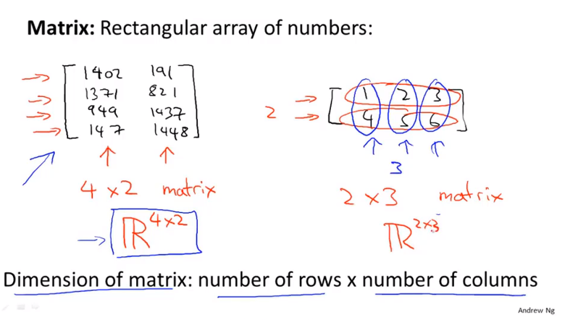
Chapter 3

Slide 3
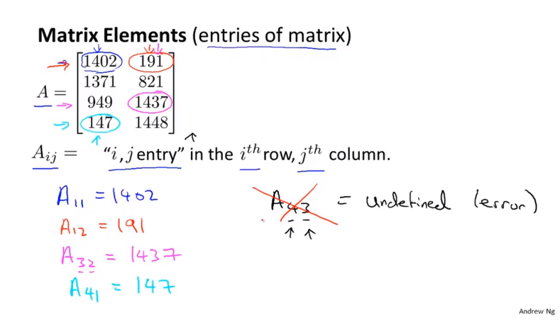
Chapter 3

Slide 4
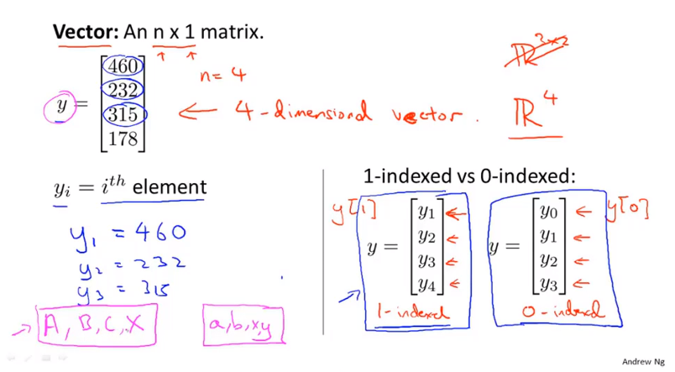
Chapter 3

Slide 5
Chapter 3
Linear Algebra review(optional)
Addition and scalar multiplication

Slide 6
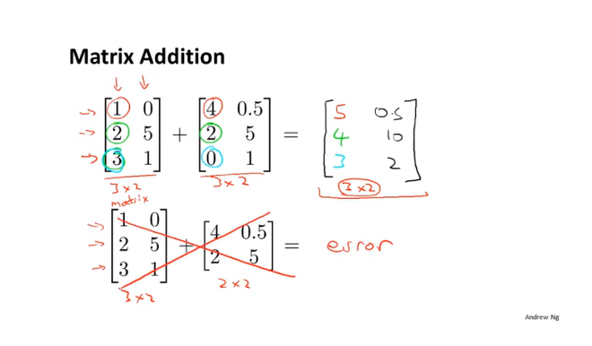
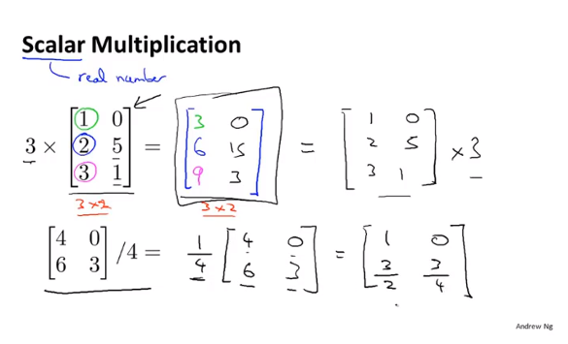
Chapter 3
You can only add two matrices that are of the same dimensions

Slide 7
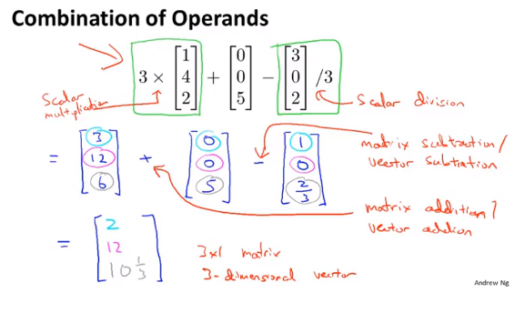
Chapter 3

Slide 8
Chapter 3
Linear Algebra review(optional)
Matrix-vector multiplication

Slide 9
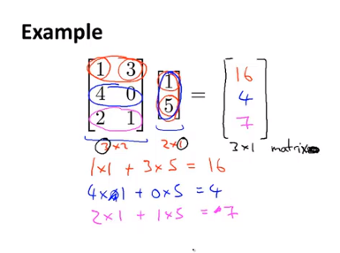
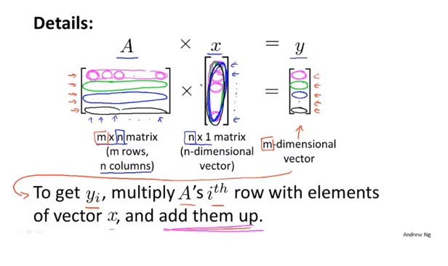
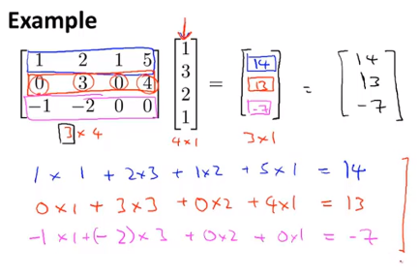
Chapter 3

Slide 10
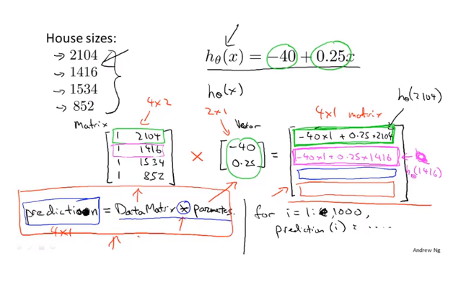
Chapter 3

Slide 11
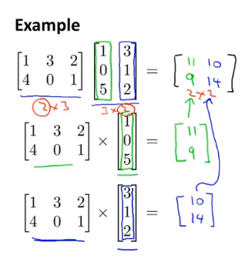
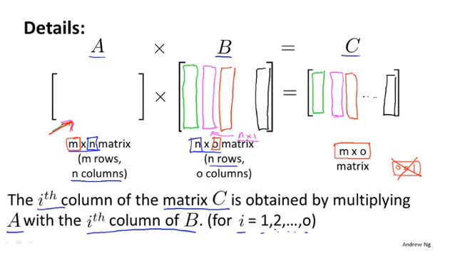
Chapter 3

Slide 12
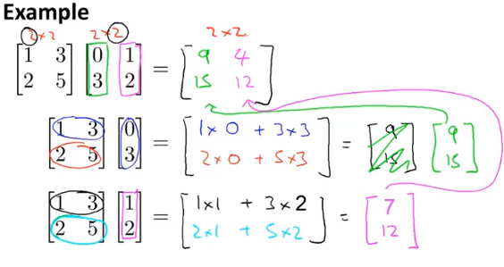
Chapter 3

Slide 13
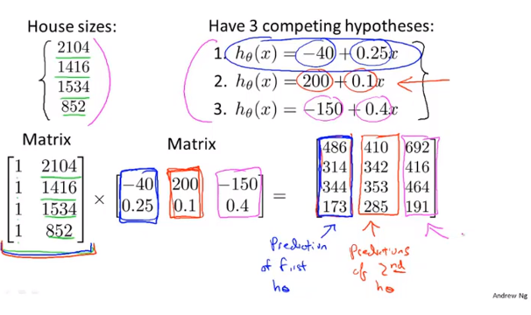
Chapter 3

Slide 14
Chapter 3
Linear Algebra review(optional)
Matrix multiplication properties

Slide 15
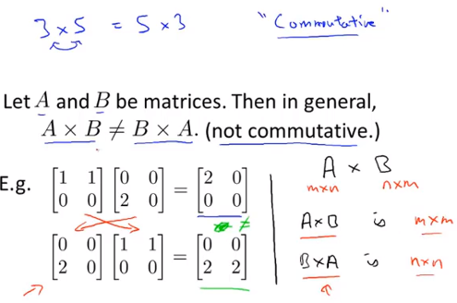
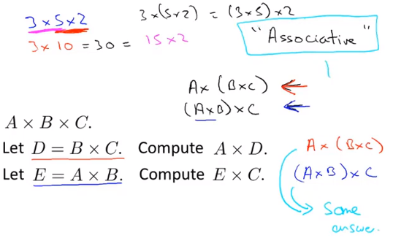
Chapter 3

Slide 16
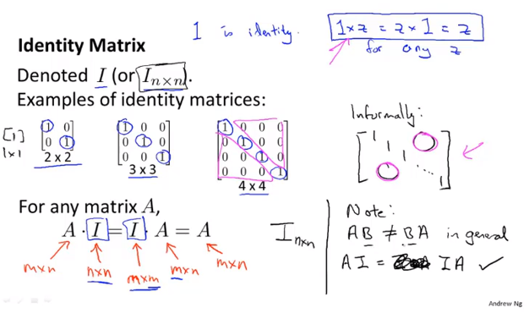
Chapter 3

Slide 17
Chapter 3
Linear Algebra review(optional)
Inverse and transpose

Slide 18
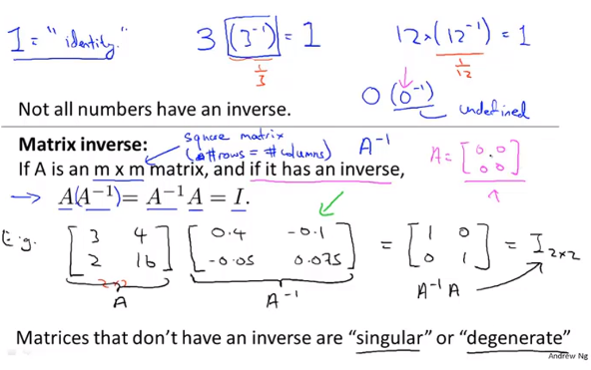
Chapter 3

Slide 19
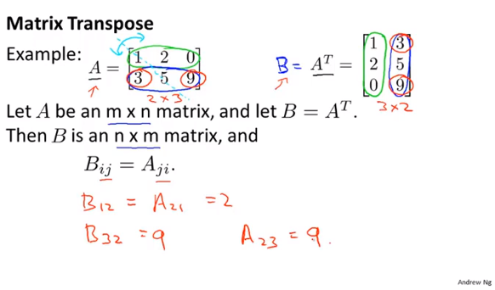
Chapter 3

